Slide 1
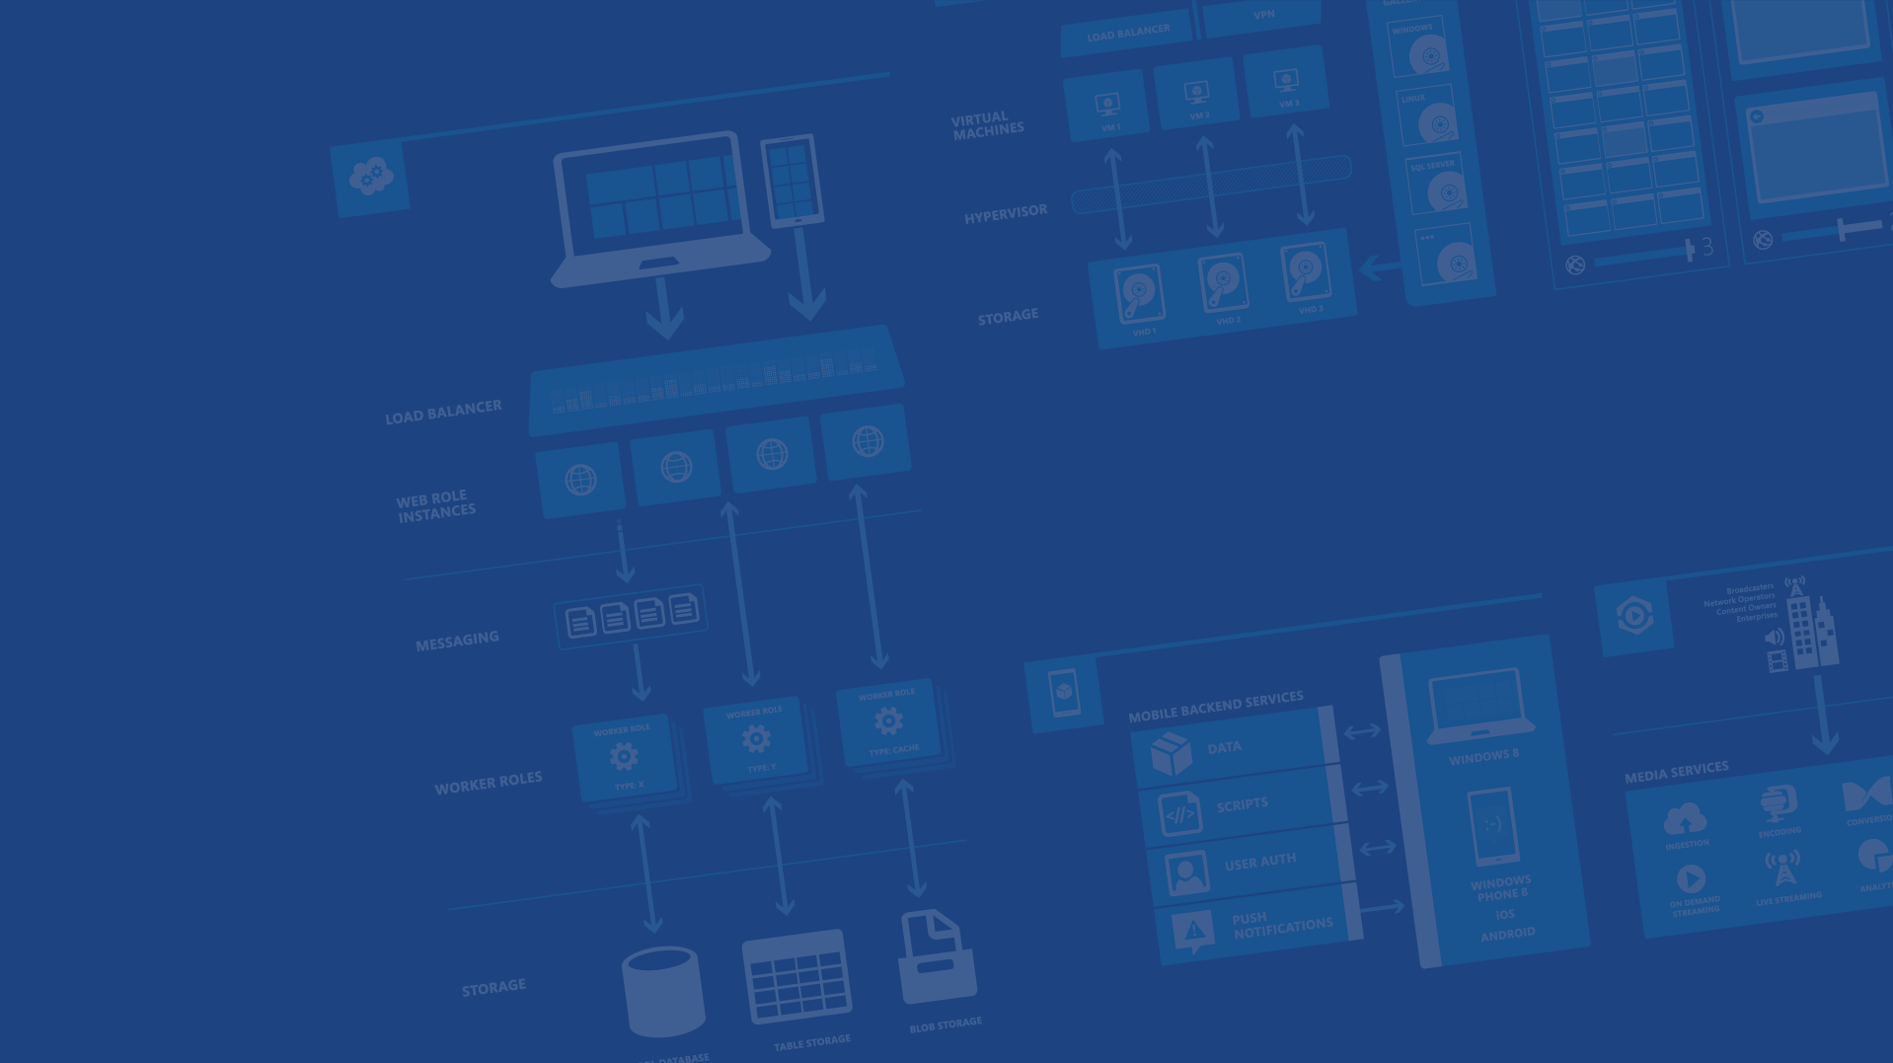
Azure IoT Hub – Raspberry Pi
P. Tsilopoulos – K. Ziazios
Software Engineer - Developer
Microsoft Azure

Slide 2
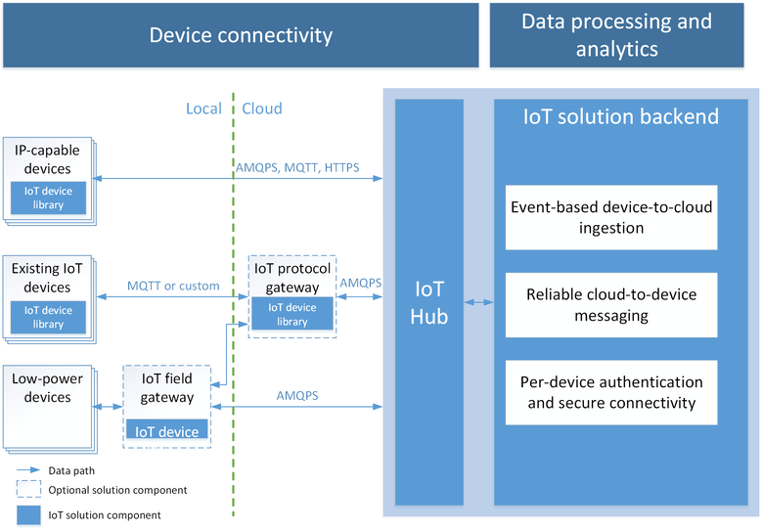
What is IoT
Notes:
https://azure.microsoft.com/en-us/documentation/articles/iot-hub-what-is-iot-hub/

Slide 3
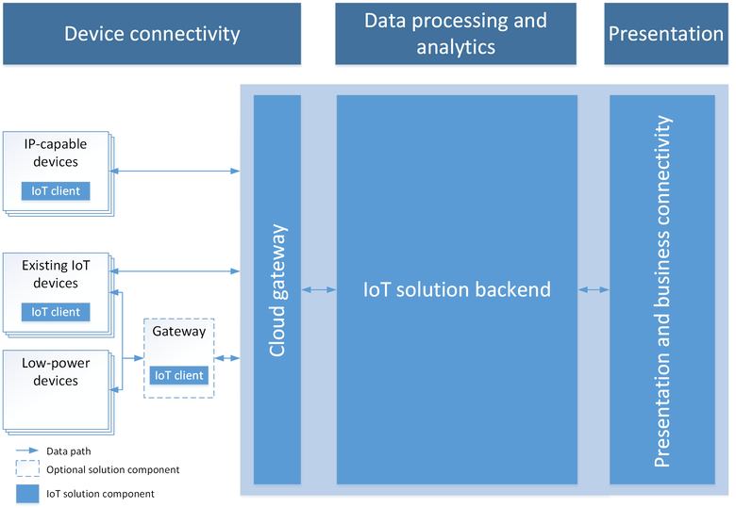
IoT solution architecture
Notes:
https://azure.microsoft.com/en-us/documentation/articles/iot-hub-what-is-azure-iot/

Slide 4
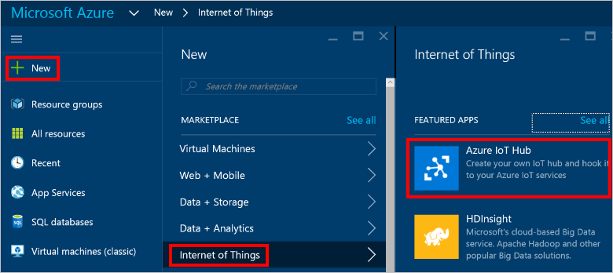
Create an IoT hub - 1
Notes:
https://azure.microsoft.com/en-us/documentation/articles/iot-hub-csharp-csharp-getstarted/

Slide 5
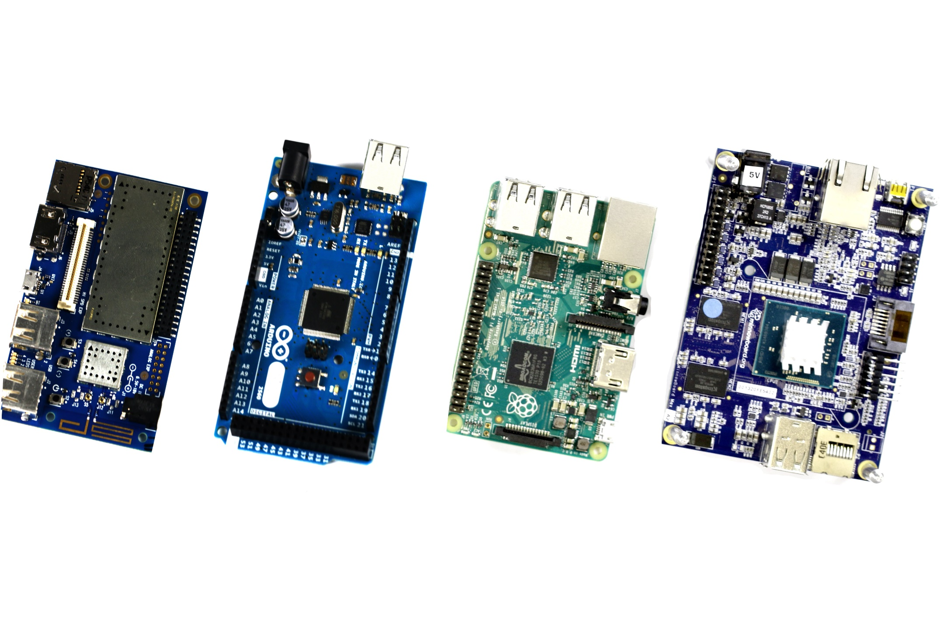
Connect your device
Notes:
https://azure.microsoft.com/en-us/develop/iot/get-started/
https://github.com/Azure/azure-iot-sdks
https://dgkanatsios.com/2016/03/09/raspberry-pi-sense-hat-azure-iot-hub-oh-my/
Cool Demo
https://www.youtube.com/watch?v=u5oTz1e5qqE
More advance application
https://azure.microsoft.com/en-us/blog/mydriving-an-azure-iot-and-mobile-sample-application/?wt.mc_id=DX_836278&sf24369366=1

